Slide 1
Module 1: Lesson 3 Confounding Factors

Slide 2
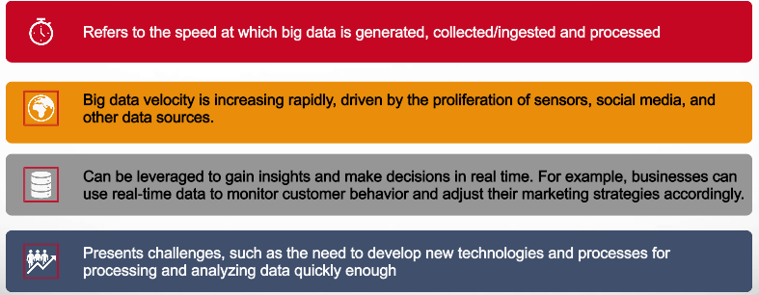
What is Big Data Velocity?
1,000 gigabytes in a terabyte, 1,000 terabytes in a petabyte​ 1,000 petabytes in an exabyte, 1,000 exabytes in a zettabyte​

Slide 3
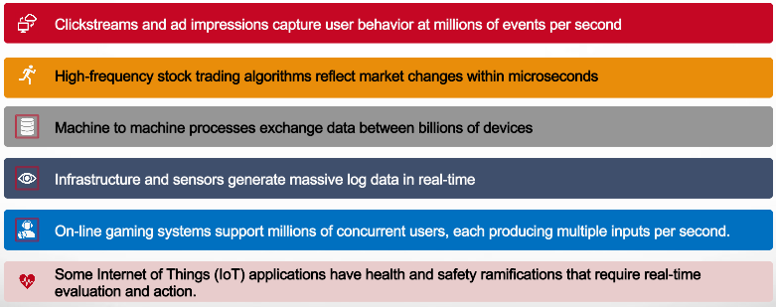
Why is Handling High Velocity Important?
1,000 gigabytes in a terabyte, 1,000 terabytes in a petabyte​ 1,000 petabytes in an exabyte, 1,000 exabytes in a zettabyte​

Slide 4
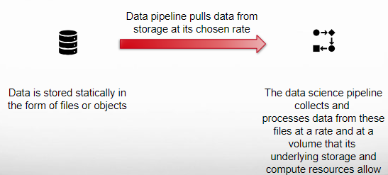
Batch Versus High Velocity Processing Batch Processing
Assumes that historical data is available from some storage system and can be obtained at a rate and in a volume controlled by the data science pipeline

Slide 5
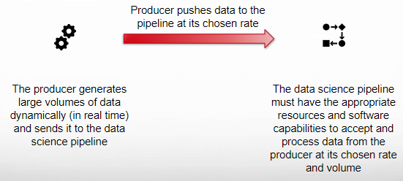
Batch Versus High Velocity Processing High Velocity (Streaming Data) Processing
Assumes that a producer generates large volumes of data at a (high) rate which the data pipeline must collect and analyze at speed or risk losing data or delaying insights

Slide 6
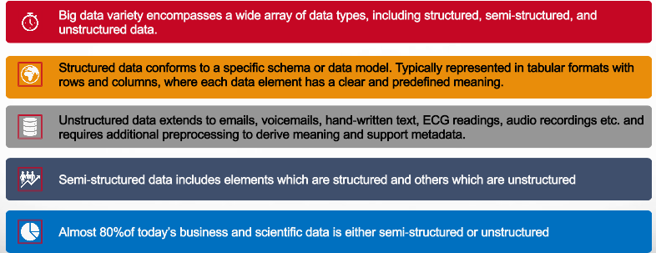
What is Big Data Variety?
1,000 gigabytes in a terabyte, 1,000 terabytes in a petabyte​ 1,000 petabytes in an exabyte, 1,000 exabytes in a zettabyte​

Slide 7
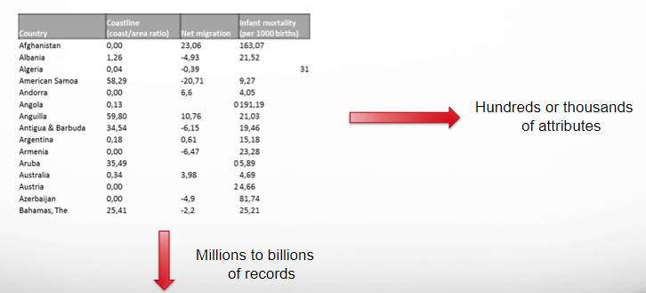
Structured Data Example

Slide 8
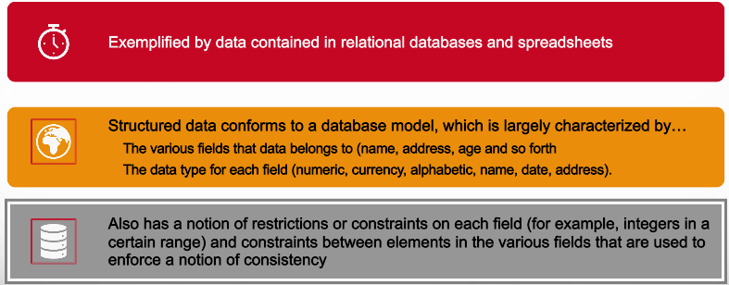
What is Structured Data?
1,000 gigabytes in a terabyte, 1,000 terabytes in a petabyte​ 1,000 petabytes in an exabyte, 1,000 exabytes in a zettabyte​

Slide 9


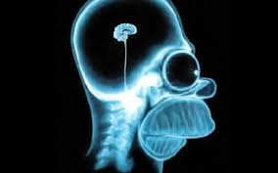
Unstructured Data Example
Picture
Audio Recording
X-Ray Image
While there may be some structured metadata associated with each of the above examples, the majority of the data is difficult to capture semantically by a simple column label.
Almost 80% of today’s business and scientific data is semi-structured or unstructured including tweets, Facebook posts, Instagram photos, etc.

Slide 10
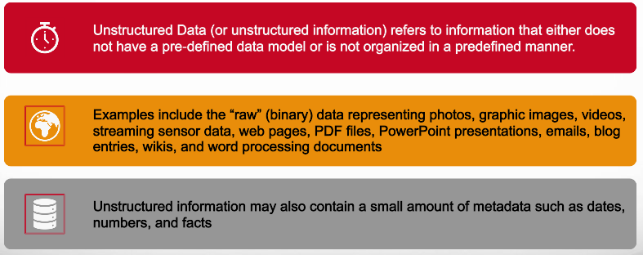
What is Unstructured Data?
1,000 gigabytes in a terabyte, 1,000 terabytes in a petabyte​ 1,000 petabytes in an exabyte, 1,000 exabytes in a zettabyte​

Slide 11
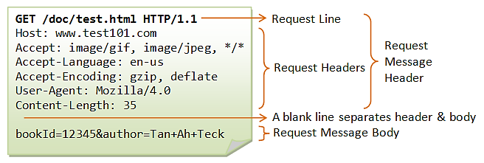
Semi-Structured Data Examples
HTTP
Request
Component | Your Value
GLUCOSE | 108 mg/dL
SODIUM | 136 meq/L
POTASSIUM | 4.0 meq/L
CHLORIDE | 101 meq/L
Study Result
Impression
IMPRESSION: 1. Stable simple cystic pancreatic foci, which likely reflect side branch intraductal papillary mucinous neoplasms; follow up in 2 years is recommended per guidelines provided below. 2. Unchanged hemorrhagic/proteinaceous left renal cyst.
Medical
Record

Slide 12
What is Semi-structured Data?
Semi-structured data is data that has some organizational properties, but does not conform to a rigid schema. Examples of semi-structured data include: JSON, XML, HTML, Log files, Email messages
For example, XML data is organized using tags and attributes, and JSON data is organized using key-value pairs.
Emails have the sender, recipient, date, time and other fixed fields added to the unstructured data of the email message content
This makes semi-structured data easier to process and analyze than unstructured data, but it is still not as easy to process and analyze as structured data
Once understood, semi-structured and unstructured data have many of the same requirements as structured data, such as summarization, lineage, auditability, and privacy.

Slide 13
What is Big Data Veracity?
Veracity is the degree to which data is accurate, consistent, complete, precise, and trustworthy and able to support reliable decisions
As the world moves toward automated decision-making, where computers make choices instead of humans, it becomes imperative that organizations be able to trust the quality of the data
Veracity is important because it is essential for making reliable decisions based on big data. Inaccurate, incomplete, and unreliable data can lead to misleading insights and decisions.
But big data is of a volume or velocity such that confirmation of its accuracy, completeness, etc. is beyond human capacity to evaluate and beyond the ability of traditional technologies to automate efficiently
1,000 gigabytes in a terabyte, 1,000 terabytes in a petabyte​ 1,000 petabytes in an exabyte, 1,000 exabytes in a zettabyte​

Slide 14
Veracity Dimensions
Accuracy vs. Inaccuracy
Truthfulness vs. (Deliberate) Deception
Consistency vs. Inconsistency
Completeness vs. Incompleteness
Objectivity vs. Subjectivity (i.e. opinion, bias)
Plausibility vs. Implausibility

Slide 15
Sources of a Lack of Data Veracity
Biasedness
Software defects
Noise
Abnormalities
Uncertainty
Data lineage
Bias or data bias is an error in which some data elements have more weightage than others, resulting in inaccurate data when an organization decides on calculated values that are suffering from statistical bias.
Software or application bugs can transform or miscalculate the data.
The non-valuable data in the datasets is known as noise. High noise will increase data cleaning work as they have to remove the unnecessary data to get better insights.
Abnormality or anomaly in the data is the data point that is not normal or the data point that stands out from the actual data
Uncertainty can be defined as doubt or ambiguity in the data. Uncertain data contains noise that deviates from the correct, intended, or original values.
Organizations collect data from multiple sources, but sometimes an inaccurate source is discovered without historical reference

Slide 16
Some Drawbacks of Lack of Veracity
According to Gartner’s research, an organization’s average cost is $9.7 million per year due to poor data quality.
According to IBM, businesses lose $3.1 trillion in the US only due to poor data quality
80% of companies believe they lose revenue due to poor data quality challenges, identified by Cio.com.
Employees spend half of their time juggling with managing the data accuracy tasks.
21% of businesses faced reputation issues and lost 30% of their revenue due to insufficient data, leading to mail delivery issues reported by Econsultancy.com.

Slide 17
What is Big Data Variability?
Refers to the diverse and dynamic nature of data in various dimensions
Can pose a number of challenges for organizations, including data storage and processing challenges, data integration challenges, and data analysis challenges.
[Source: https://dictionary.cambridge.org/us/dictionary/english/data]

Slide 18
What are Big Data Variability Dimensions?
Source variability: Big data is often sourced from a wide array of channels, including social media, sensors, online transactions, and more. The diversity in sources introduces variability in terms of format and structures, necessitating advanced data integration and processing techniques
Semantic Variability: The meaning of data elements can vary across different contexts or domains which requires data scientists to establish clear ontologies and data dictionaries to ensure accurate interpretation of information
Velocity variability: Big data can be generated at different speeds, from real-time data streams to batch data that is updated periodically. This variability can make it difficult to keep up with the influx of data and to ensure that data is analyzed in a timely manner
Quality variability: Big data can vary in quality, from clean and accurate data to noisy and incomplete data. This variability can make it difficult to trust the results of big data analysis
[Source: https://dictionary.cambridge.org/us/dictionary/english/data]

Slide 19
What is Big Data Value? (As a Complicating Factor)
Value is the business, economic, social, research, technical or cultural benefits derived from the collection, storage, processing and analysis of big data
The value of big data comes from insight discovery and pattern recognition that lead to more effective operations, stronger customer relationships and other clear and quantifiable benefits
Due to its volume, velocity and variety, etc. it is difficult, time consuming and costly to obtain the value of big data using a data science pipeline enabled by traditional data collection, storage and processing technology
But to remain competitive, firms and research organizations absolutely must obtain value and uncover insights from their investment in collecting vast and diverse datasets.
1,000 gigabytes in a terabyte, 1,000 terabytes in a petabyte​ 1,000 petabytes in an exabyte, 1,000 exabytes in a zettabyte​

Slide 20
What is Big Data Value? (As a Complicating Factor)
Parallel processing is a paradigm where hundreds or thousands of processing nodes work on parts of a computational task in parallel
Each of these nodes run individual instances of an operating system, have their own input and output devices, and do not share memory
These nodes might have private storage capacity (disk or solid state) and also share common network storage
Processing nodes achieve a common computational task by communicating with each other via message passing over a high-speed interconnect
1,000 gigabytes in a terabyte, 1,000 terabytes in a petabyte​ 1,000 petabytes in an exabyte, 1,000 exabytes in a zettabyte​

